Slide 1

Helping your child with their reading journey in KS1.

Slide 2

At Ham Dingle, we recognise that competence in speaking, listening, reading and writing underpin the whole curriculum. Therefore, a quality English curriculum should develop our pupils’ love of reading, writing and discussion. Our aim is to enable our pupils to become confident and able writers, who make conscious links to reading.
We aim for our children to write as a readers and read as writers.

Slide 3

Reading at Ham Dingle in Key Stage One:
At Key Stage One, all children access whole class reading (WCR) and a separate writing session daily. Reading enables children access to expert writers and will be taught comprehension skills to secure their understanding. This is in addition to daily phonics lessons.
Throughout their time at Ham Dingle, children will follow our core Literature Spine, which has been carefully planned to include:
Texts that explore specific social, ethical and moral issues
Texts that are considered to be classics or “the Greats”
Texts that have strong female role models
Texts with familiar/well-known authors and those with upcoming, diverse authors
Texts that explore British and world heritage
We want our children to know that “THERE IS A BOOK FOR EVERYONE!”

Slide 4
Literature Spine
Year 1 Literature Spine
Year 2 Literature Spine

Slide 5
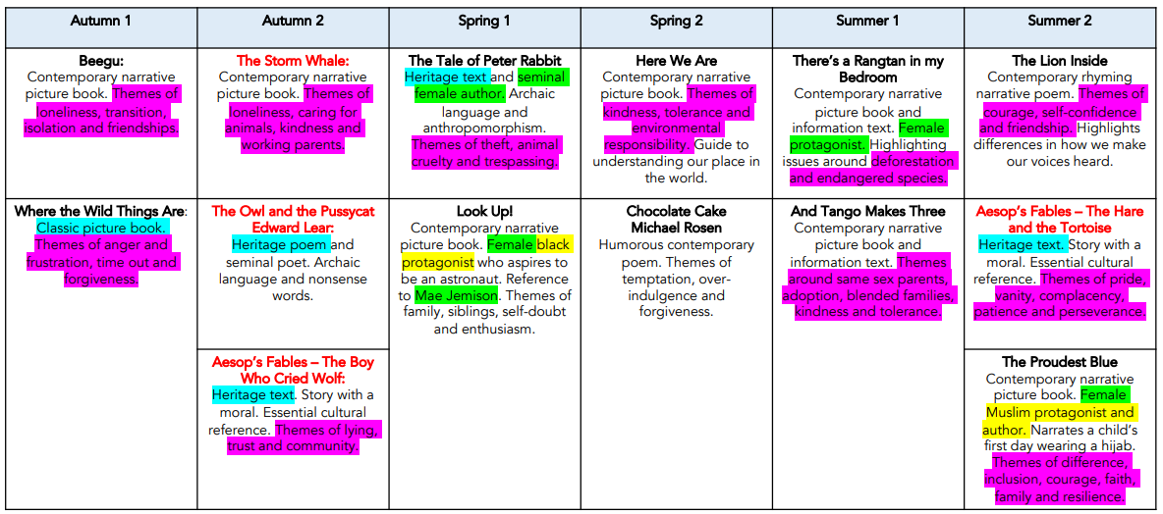

Literature Spine – Year 1
Year 5 Literature Spine

Slide 6
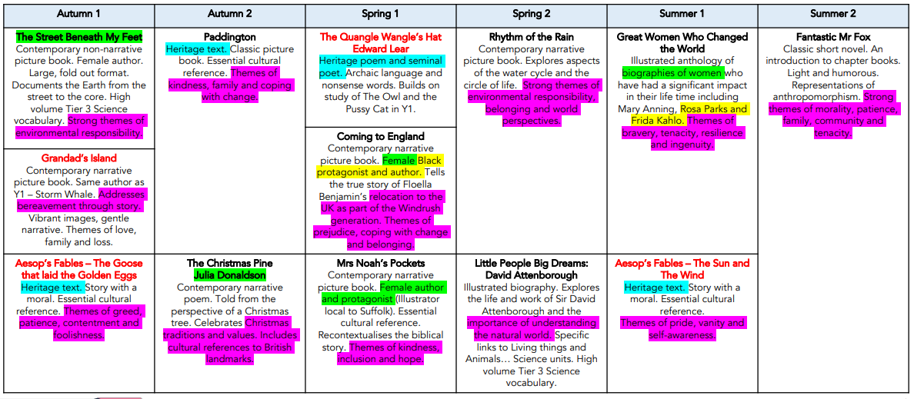
Literature Spine – Year 2
Year 5 Literature Spine

Slide 7

In addition to whole class teaching of Reading, children are also encouraged to read for pleasure at home. For this, we use the school and class library books. We ‘Drop Everything and Read’ straight after lunch in KS1 and listen to at least one story per day. We also listen to a longer story (chapter book) at the end of each day.
Children’s Reading fluency and comprehension skills are assessed in two ways:
Teacher assessment during daily WCR lessons (formative assessment).
Termly written Reading test (PIRA test) (summative assessment
that is shared with parents).

Slide 8

KS1 Reading lessons are built around teaching pupils 5 reading skills
Give/explain the meaning of words in context. (VOCABULARY)
Retrieve and record information/identify key details from fiction and non-fiction. (RETRIEVE)
Sequence the events of the text in the correct order. (SEQUENCE)
Predict what might happen from details stated and implied (PREDICT)
Make inferences from the text/explain and justify inferences with evidence from the text. (INFER)
These are the 3 main areas of focus.

Slide 9
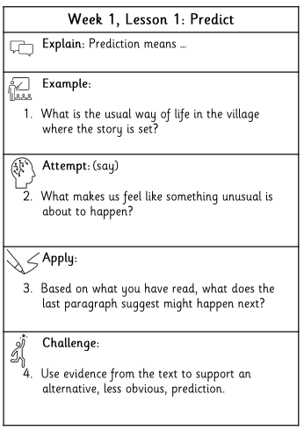

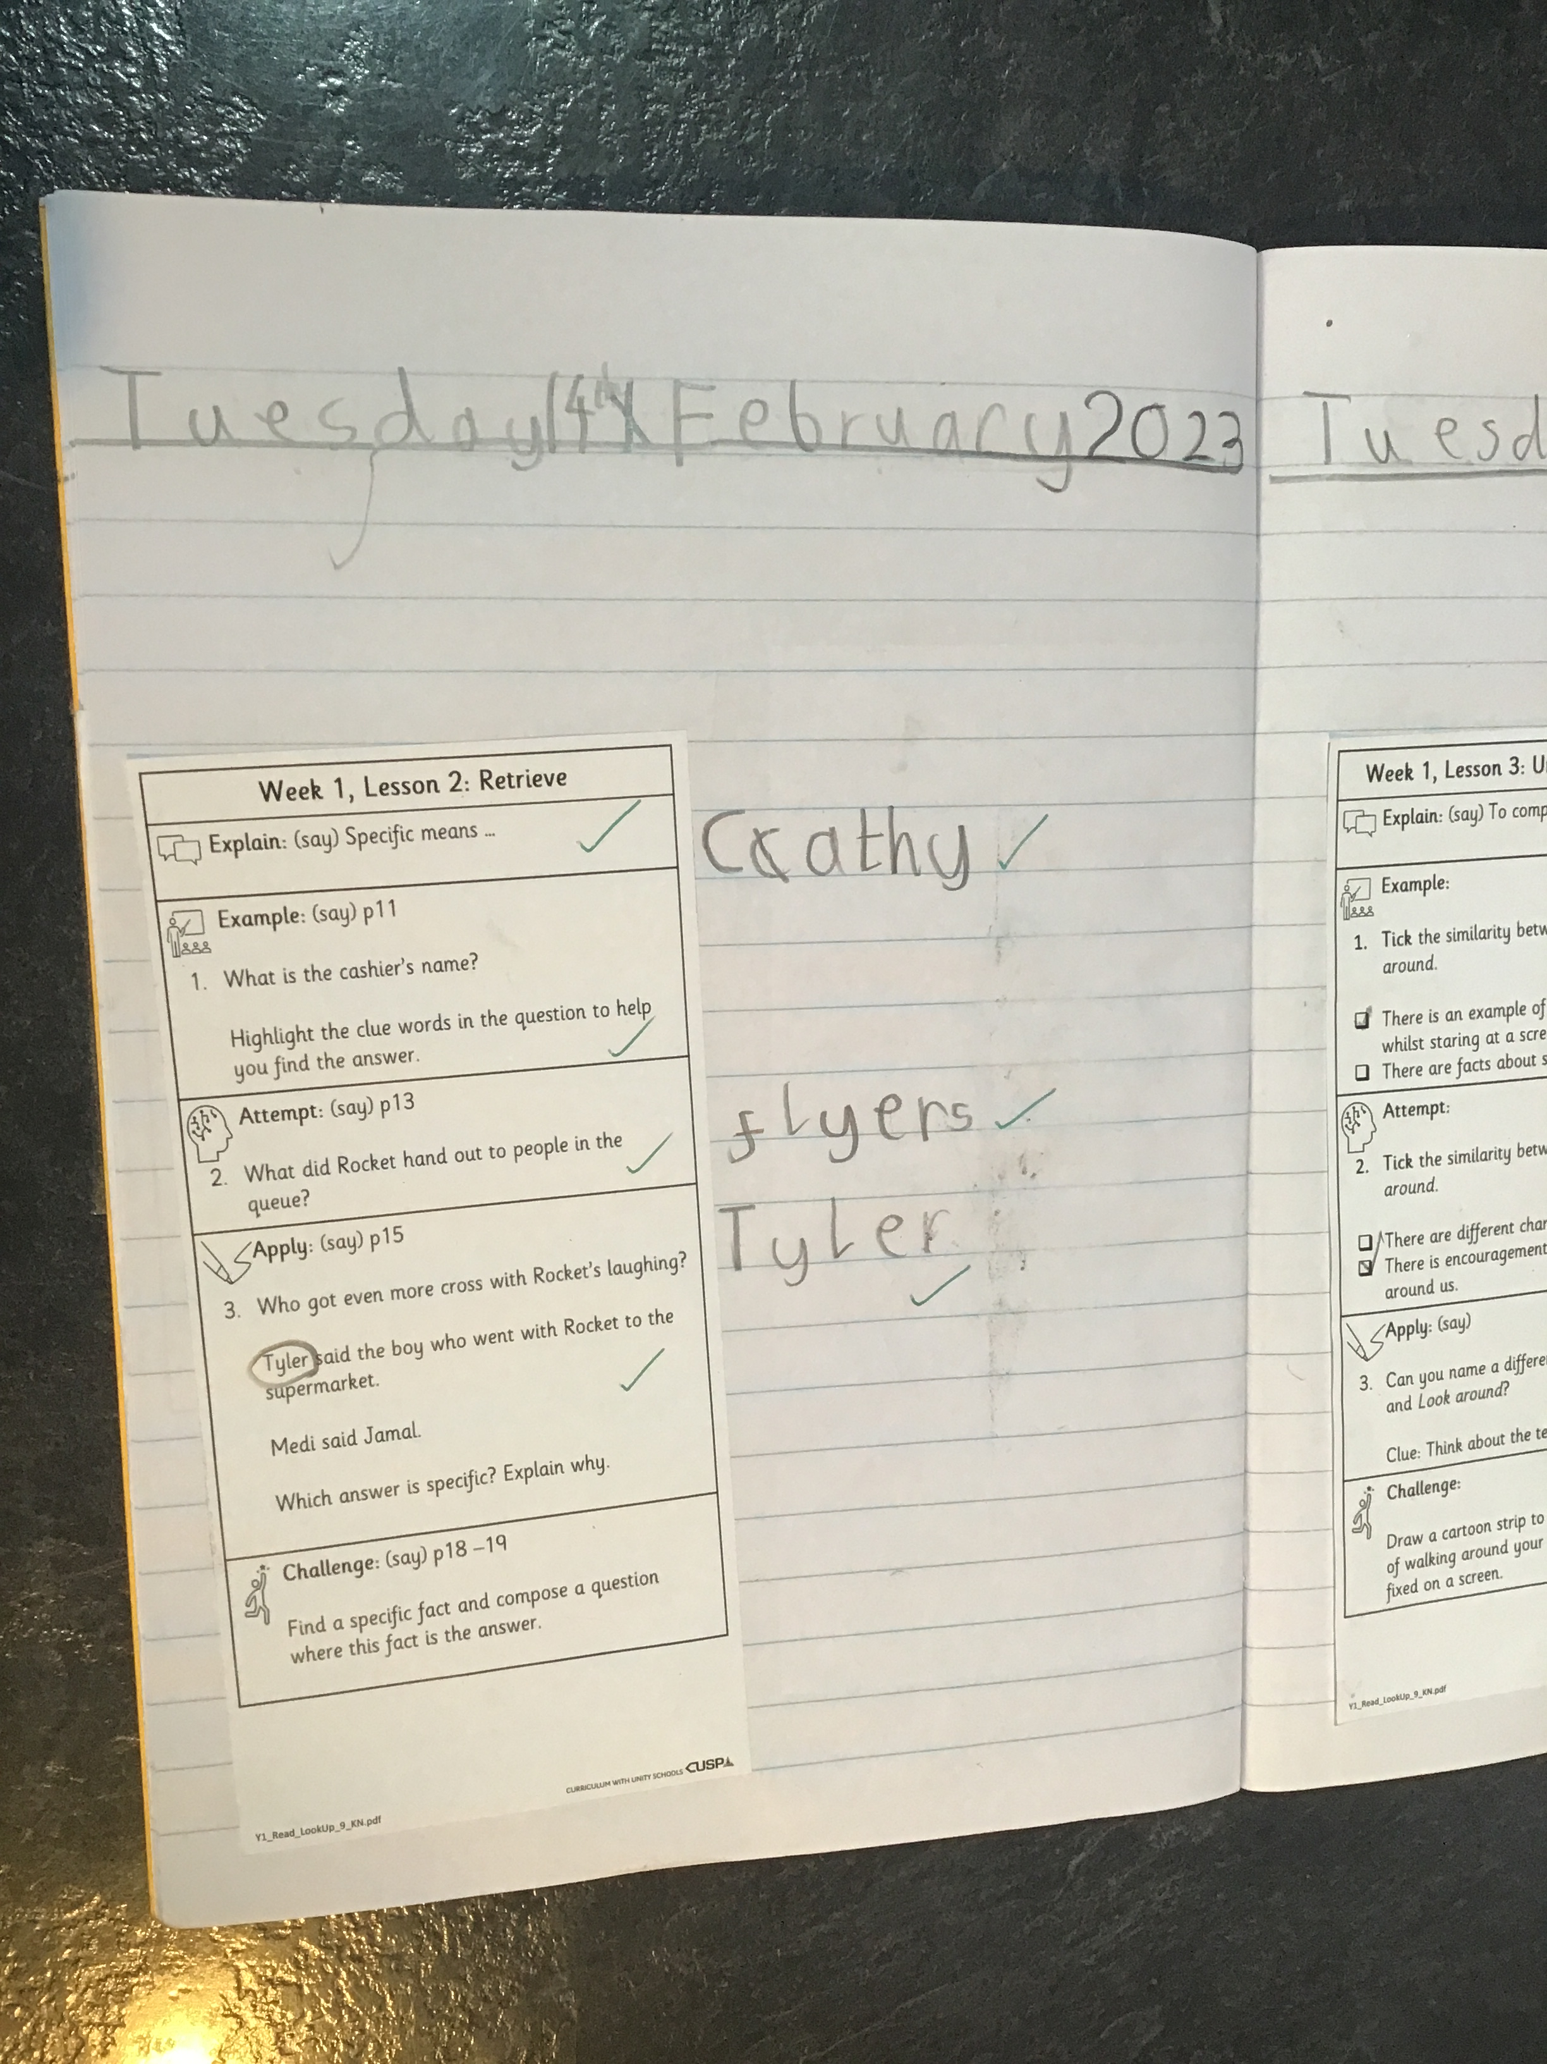
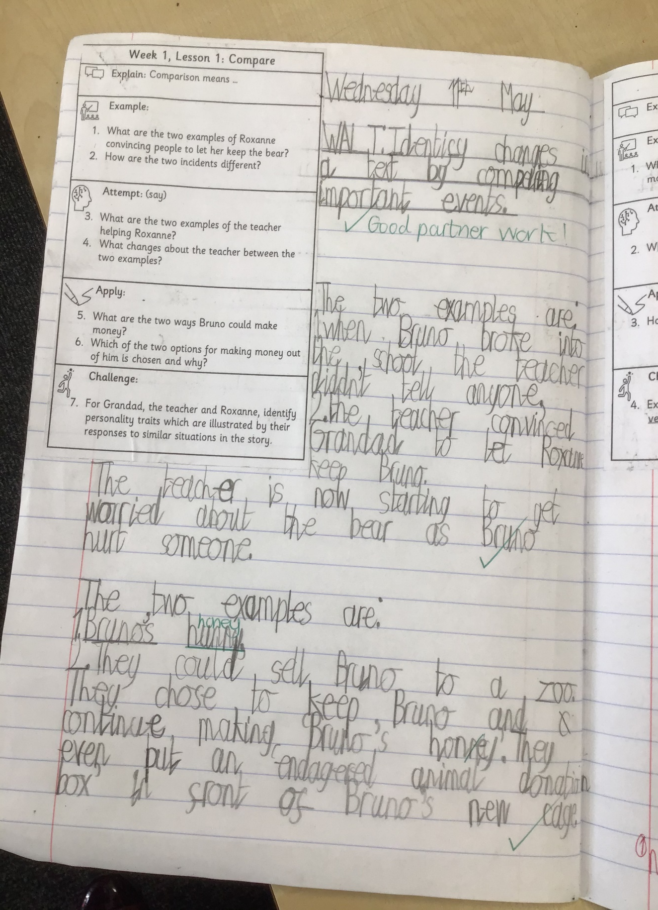
What a WCR lesson looks like:
Example Year 1:

Slide 10
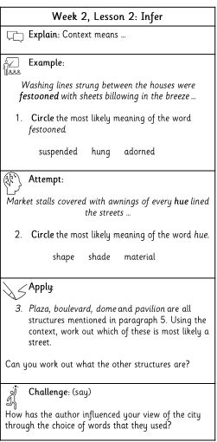


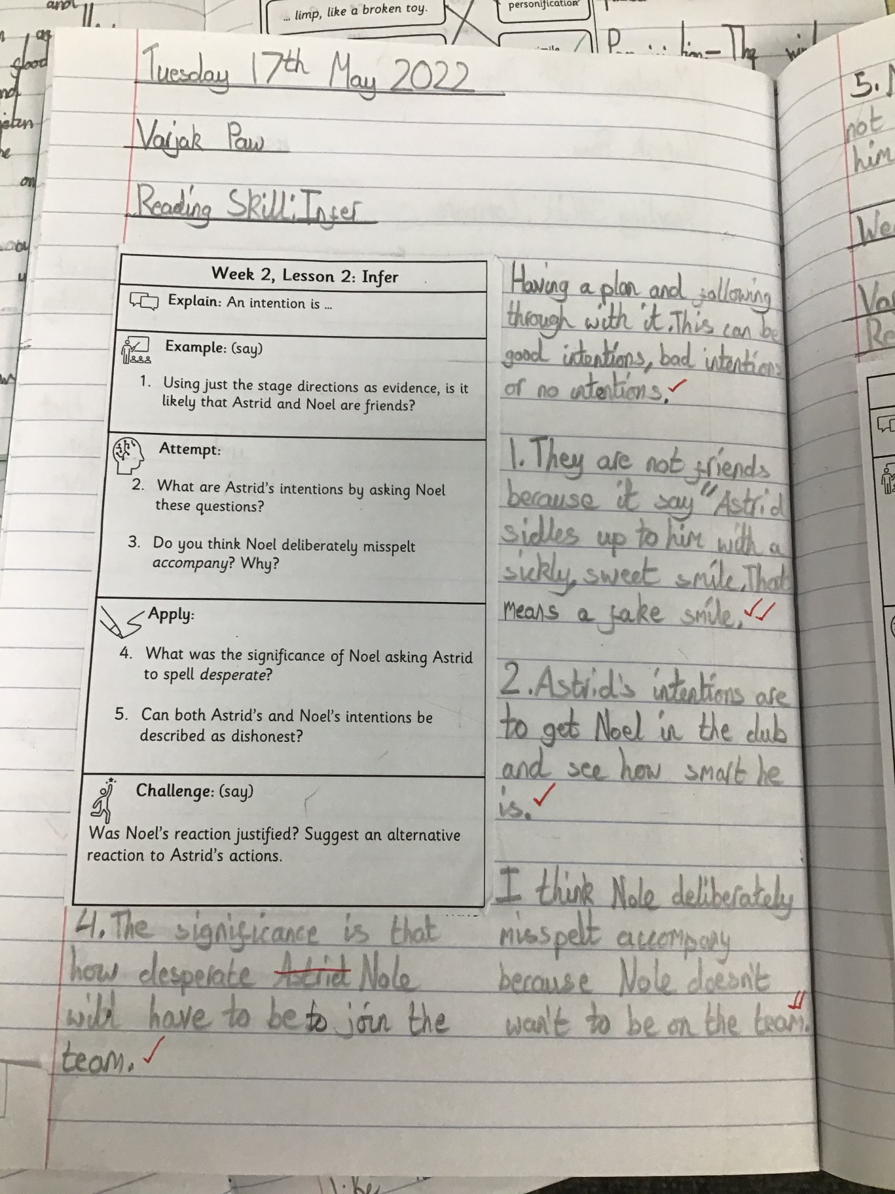
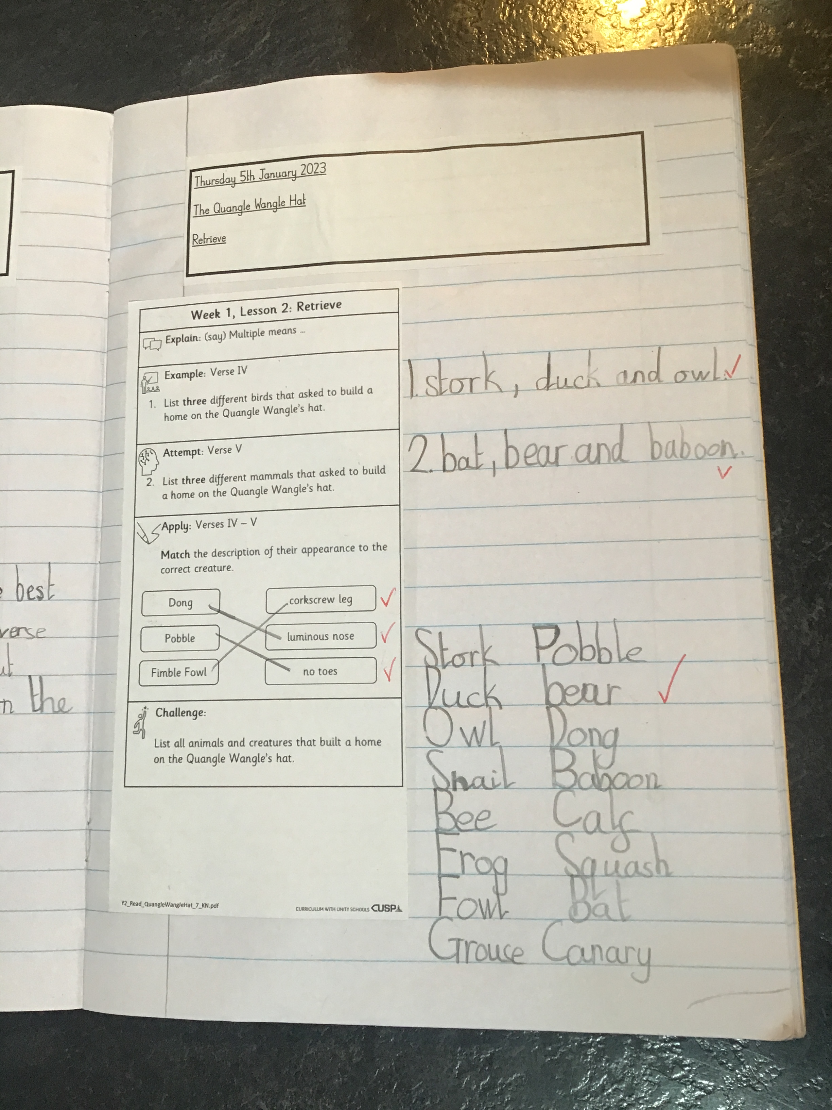
What a WCR lesson looks like:
Example Year 2:

Slide 11
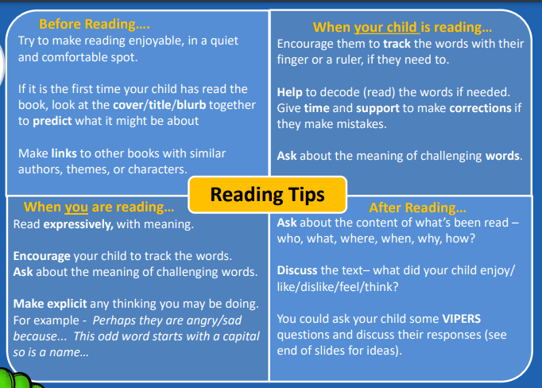
Reading tips

Slide 12
Reading tips

Slide 13
Reading tips

Slide 14
Reading tips

Slide 15
Reading tips

Slide 16
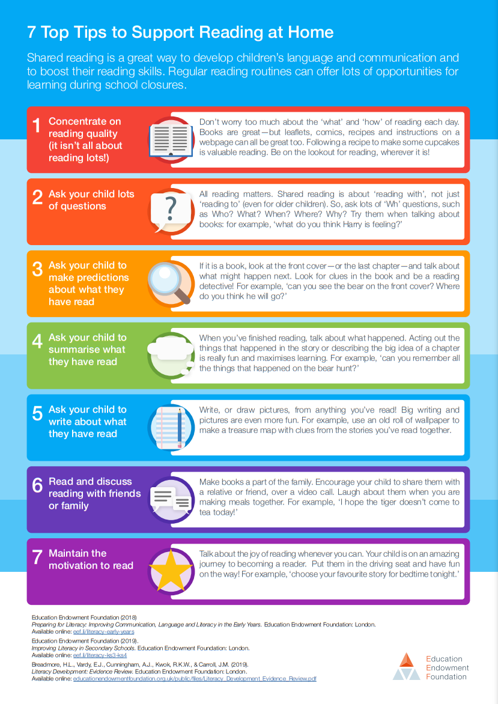
Reading tips

Slide 17
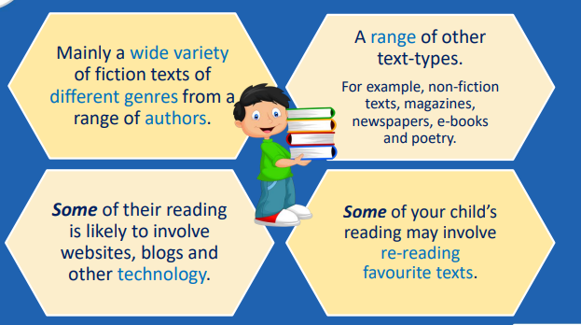
What should they be reading at home?

Slide 18

How you can help your child’s reading at KS1…
Top tips
Read in short burst – 5-10 minutes maximum
Build reading time into daily routines
Follow their interests
Use technology together
Encourage child to be the author
Simply chat about books
Share word puzzles and games (wordsearches, I spy …)
Read to them (whatever age they are!)

Slide 19

Turn the subtitles on

Slide 20
Turn the subtitles on
Turning on the subtitles while children are watching television can double the chances of a child becoming good at reading†. It’s so brilliantly simple and can help children’s literacy so much that we want to shout it from the rooftops!
†Based on an academic study of 2,350 children, 34% became good readers with schooling alone. But when exposed to 30 minutes a week of subtitled film songs, that proportion more than doubled to 70%. There are lots of studies about the benefits of subtitles. This is just one! Check out our research page to find out more.

Slide 21

Ham Dingle Reading Challenge – 50 books!
WE would like you all to complete a Reading Challenge that is going to begin from today and last until July…
YOUR CHALLENGE is to read at least 50 books!
The book title and author must be recorded on a special card.
In KS1, it can include books your family read to you at home.
In KS2, it must be books you have read.
It can include your given school books, your own books from home, home, books from school or class library areas.
You will be asked questions to check you have read any books you write on your list.
All children who complete the challenge will be entered into year prize year group prize draws to win book vouchers.

Slide 22
Thank you for attending our Reading Workshop

